Slide 1
Refactoring Responsibly
Vanquishing
the
first draft
In
production code
Drew Shefman
@dshefman
dshefman@squaredi.com

Slide 2
Who am I?
Freelance Developer / Architect / Mentor
15+ years professional multimedia experience
Adobe Certified Flex Expert / Instructor
Professor @ University of Houston
Consultant @ Twin Technologies
Drew Shefman
@dshefman
dshefman@squaredi.com

Slide 3
Who are you?
Team member that
modifies or maintains
production level,
involved,
legacy code.
You touch the code
Significant financial cost if it breaks
Likely has appreciable code smells
Code missing automated tests

Slide 4
This presentation is NOT about
Theories
Test Driven Development (TDD) guilt trips
Yesterday’s feature addition
Contrived, convoluted code

Slide 5
This presentation IS about
Practical answers for
Why refactor?
When to refactor?
How to refactor?
Enabling real-world production code refactoring
Extract & Override
Characterization tests
Refactoring Observations

Slide 6
Do NOT Wait

Slide 7
Refactoring?
What is it?
Why do it?
When?

Slide 8
What is refactoring?
“A process of changing a software system in such a way that it DOES NOT alter the external behavior of the code yet improves its internal structure”
Definition
-- Martin Fowler:
Refactoring: Improving the Design of Existing Code

Slide 9
What is refactoring?
Visual Definition
Refactored code

Slide 10
What refactoring is NOT
Adding functionality
Fixing bugs
Design enhancements
Discarding & rewriting
Substantial changes

Slide 11
When to refactor?
Ideally | Before making functional changes
Realistically | When the smell complexity trepidation fragility exceeds personal thresholds
Specifically | When all tests EXIST & PASS!

Slide 12
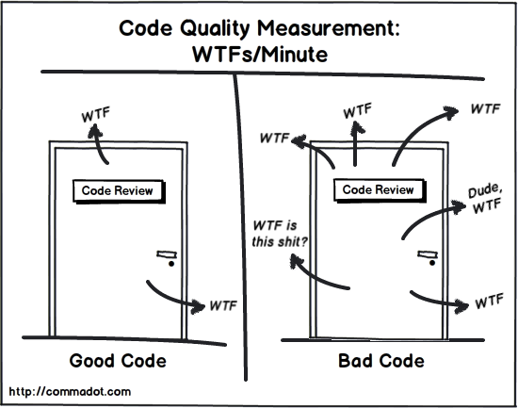
When to refactor?
Increasing refactoring opportunities

Slide 13
When NOT to refactor
For the sake of refactoring
Too many classes affected
Potentially momentarily unusable
While adding a feature
While fixing a bug
When you don’t have tests to support your change

Slide 14
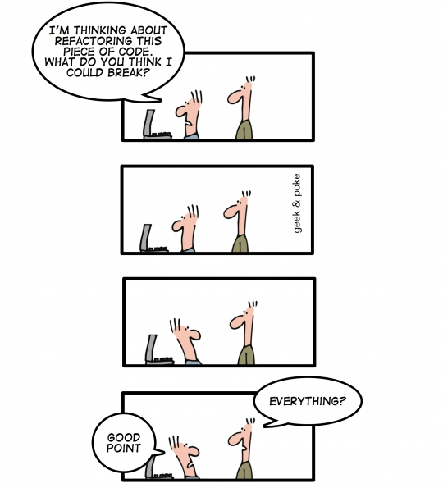
When NOT to refactor
Supporting tests are missing

Slide 15
Why is refactoring needed?
The majority of legacy code is a first draft!
If it works the first time, why change it?

Slide 16
Why not do it right the first time?
* My personal non-empirical guess, based loosely on stats from copy editors
First Drafts*
15%
Random annoying inconsistencies
25%
YAGNI
(You Ain’t Gonna Need It)
Anything important, deserves more than a first draft.
5%
GOLD
40%
not entirely hopeless, possibly reusable elements
15%
Code that belongs elsewhere

Slide 17
Why refactor?
We want to add value, not spend time searching for how it works

Slide 18
Why stake holders dislike refactoring
Fear of breaking
Refactoring = uncontrolled && high risk
No ROI to “fix” something that is “working”

Slide 19
How proper refactoring placates stake holders
Fear of Breaking | Characterization tests
Uncontrolled / high risk | Small precision efforts, backed by automated tests
Low ROI, it is already working | What is there was “working”, but it won’t with the new feature. no refactor = no feature || no bug

Slide 20
How to refactor?
Define stopping point
Identify class’s purpose
Reorganize within class
Characterization tests
Extract & Override*
All tests pass
Modify the code
Verify all tests pass
*optional

Slide 21
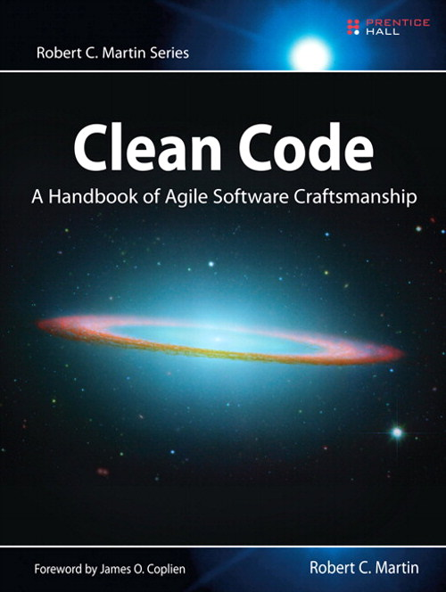
How to refactor? Resources

Slide 22
How to refactor? Tools
Extract Method
Extract Interface
Extract Variable
Extract Field
…

Slide 23
How to refactor? Tools: Extract Method
PLUGIN: SourceMate
by ElementRiver
IDE: IntelliJ by JetBrains

Slide 24
Case Study: Order Presentation Model
The Code
Define stopping point
Identify class purpose
Reorganize within class
Create characterization tests
Extract & Override
Verify all tests pass
Refactor

Slide 25
Original Class: Excessive Duplication
Similar methods
openCreateNewOrderPopUp()
openQuickOrderPopup()
openImportOrderPopup()
exportOrder()
showCancelNotEditableOrder()
showModifyNotEditableOrder()

Slide 26
Original Class: Excessive Duplication
Similar methods
Duplication Code Pattern
openCreateNewOrderPopUp()
openQuickOrderPopup()
openImportOrderPopup()
exportOrder()
showCancelNotEditableOrder()
showModifyNotEditableOrder()
if (submittedOrder)
{
alertUser(uniqueMessage)
}
else
{ showPopup(uniqueView)
}

Slide 27
Original Code
public function openCreateNewOrderPopUp():void
{
if (orderModel.inMSOState)
{
alertMSOToUser(RequestTypesBeforeSwitchingMSO.CREATE_NEW_ORDER)
}
else
{
var createOrderPopup:CreateOrderView = new CreateOrderView() ;
new SM_PopupComponentEvent(createOrderPopup,true).dispatch()
}
}
if (submittedOrder)
alertUser(msg)
createPopup(instance)
Notes:
8 nearly identical functions
openImportOrderPopup(), openExportOrderPopup()…
3 different mechanisms for creating an alert
mx:Alert, spark:SparkAlert, project:ProjectAlert
Inconsistency in Alert labels, widths and heights
Varies from defined ideal SRP
Besides, it is an easy one to use as a teaching example

Slide 28
Before starting to refactor…
Predetermine specifically when
you are going to stop.
There is ALWAYS more to clean up.
Notes:
Possible options:
Team understands and unafraid to make changes
Code is slightly better then before
You’ve hit the end of your timebox

Slide 29
Determining when to stop
No changes to public interface
Popup & alert duplication eliminated
100% test coverage on public interface

Slide 30
Indentifying Purpose
Ideal Purpose
Actual Purpose
Manage
creating,
reading,
updating, &
deleting*
orders by dispatching business events
Order CRUD events
Create alerts & popups
Handle responses from alerts & popups
Pricing processing
Date processing
Holding order state
*CRUD

Slide 31
Indentifying Purpose
Knowing the purpose helps determines what stays in and what moves out.

Slide 32
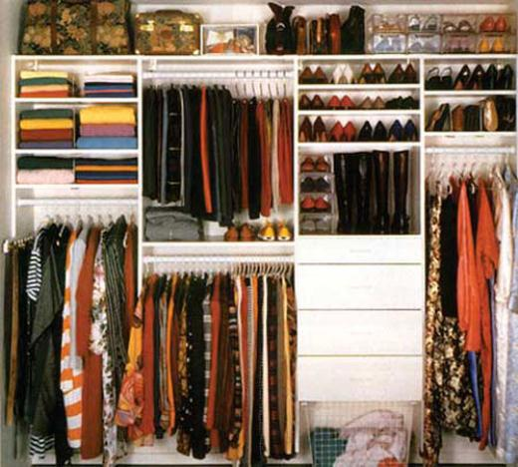
Intra-Class Organization
Rearrange / cluster related variables and methods
Organize imports
Remove disabled code (commented)
Remove UNUSED private variables / methods

Slide 33
Use EXTREME confidence while organizing

Slide 34
Characterization Tests
Characterization test:
A means to describe (characterize) the actual behavior of an existing piece of software, and therefore protect existing behavior of legacy code against unintended changes via automated testing.
--Wikipedia

Slide 35
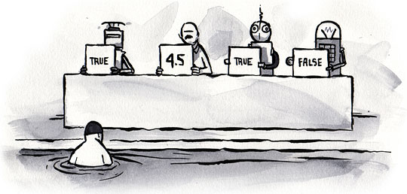
Characterization Tests
One method at a time
Exercise the ENTIRE method
Testing might not be easy.

Slide 36
Testing Challenges
public function openCreateNewOrderPopUp():void
{
if (orderModel.inMSOState)
{
alertMSOToUser(RequestTypesBeforeSwitchingMSO.CREATE_NEW_ORDER)
}
else
{
var createOrderPopup:CreateOrderView = new CreateOrderView() ;
new SM_PopupComponentEvent(createOrderPopup,true).dispatch()
}
}
Dependency to OrderModel
Must exist
Must be in correct state
Notes:
CreateOrderView popup isn’t a business event
Confirmation Alert will then call duplicated CreateOrderView Popup code
Can’t even start testing until we resolve dependency

Slide 37
Testing Challenges
public function openCreateNewOrderPopUp():void
{
if (orderModel.inMSOState)
{
alertMSOToUser(RequestTypesBeforeSwitchingMSO.CREATE_NEW_ORDER)
}
else
{
var createOrderPopup:CreateOrderView = new CreateOrderView() ;
new SM_PopupComponentEvent(createOrderPopup,true).dispatch()
}
}
Private method, calling Alert.show()
Creates a visual element
Difficult to verify
Notes:
CreateOrderView popup isn’t a business event
Confirmation Alert will then call duplicated CreateOrderView Popup code
Can’t even start testing until we resolve dependency

Slide 38
Testing Challenges
public function openCreateNewOrderPopUp():void
{
if (orderModel.inMSOState)
{
alertMSOToUser(RequestTypesBeforeSwitchingMSO.CREATE_NEW_ORDER)
}
else
{
var createOrderPopup:CreateOrderView = new CreateOrderView() ;
new SM_PopupComponentEvent(createOrderPopup,true).dispatch()
}
}
Cairngorm 2, static event dispatcher
Event doesn’t broadcast from this class
Annoying to capture
Notes:
CreateOrderView popup isn’t a business event
Confirmation Alert will then call duplicated CreateOrderView Popup code
Can’t even start testing until we resolve dependency

Slide 39
Testing Challenges
public function openCreateNewOrderPopUp():void
{
if (orderModel.inMSOState)
{
alertMSOToUser(RequestTypesBeforeSwitchingMSO.CREATE_NEW_ORDER)
}
else
{
var createOrderPopup:CreateOrderView = new CreateOrderView() ;
new SM_PopupComponentEvent(createOrderPopup,true).dispatch()
}
}
Dependency to orderModel
Private method, calling Alert.show
Cairngorm 2, static event dispatcher
Notes:
CreateOrderView popup isn’t a business event
Confirmation Alert will then call duplicated CreateOrderView Popup code
Can’t even start testing until we resolve dependency

Slide 40
Challenges: Dependency to OrderModel
Ill-suited
Suitable
OrderModel instance
Many other dependencies
Not part of the testing “unit”
Mocking
Introducing an unfamiliar framework was not an appropriate option at the time
Extract & Override
Improves readability
Enables dependency breaking within tests
Immediately understandable

Slide 41
Extract Method
Original
Extracted Method
if (orderModel.inMSOState)
…
if (modifyingSubmittedOrder())
…
protected function modifyingSubmittedOrder():Boolean
{
return orderModel.inMSOState
}
Potential for dependency elimination in subclass

Slide 42
Subclass: OrderPresentationModelTester
public class OrderPresentationModelTester extends OrderPresentationModel
{
public var isModifiyingSubmittedOrder:Boolean = false;
override protected function modifyingSubmittedOrder():Boolean
{
return isModifiyingSubmittedOrder;
}
}

Slide 43
OrderPresentationModelTest
[Test]
public function openCreateNewOrderPopup_NotMSO_PopupEventWCreateOrderView():void
{
var orderPresentationModel:OrderPresentationModel = new OrderPresentationModelTester();
orderPresentationModel.openCreateNewOrderPopUp();
fail(“The test compiles and fails… tests are working”);
}

Slide 44
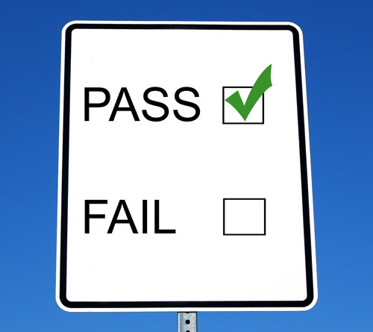
Test Fails – This is good

Slide 45
What are we testing again?
public function openCreateNewOrderPopUp():void
{
if (modifyingSubmittedOrder())
{
alertMSOToUser(RequestTypesBeforeSwitchingMSO.CREATE_NEW_ORDER)
}
else
{
var createOrderPopup:CreateOrderView = new CreateOrderView() ;
new SM_PopupComponentEvent(createOrderPopup,true).dispatch()
}
}
Test that event is dispatched with a 2 item payload

Slide 46
Reminder – not ideal environment
We are here.
Unfortunately, we are not here.

Slide 47
CairngormEventRecorder
public class CairngormEventRecorder
{
public static function create():CairngormEventRecorder
{
var rtn:CairngormEventRecorder = new CairngormEventRecorder();
CairngormEventDispatcher.addEventListener(
SM_PopupComponentEvent.EVENT,
rtn.recordEvent,
false,0,true);
return rtn;
}
public static function destroy(inst:CairngormEventRecorder):void
{
CairngormEventDispatcher.removeEventListener(
SM_PopupComponentEvent.EVENT,
inst.recordEvent);
}
}
Capture Cairngorm events minimizing memory leaks

Slide 48
CairngormEventRecorder - Continued
public class CairngormEventRecorder
{
public var storedEvents:Array = [];
public function recordEvent(e:Event):void
{
storedEvents.push(e);
}
public function getLastEvent():Event
{
var len:int = storedEvents.length
if (len >0)
{
return Event(storedEvents[len]);
}
return null;
}
}
Save / retrieve dispatched
Cairngorm events

Slide 49
OrderPresentationModelTest
[Test]
public function openCreateNewOrderPopup_NotMSO_PopupEventWCreateOrderView():void
{
var eventRecorder:CairngormEventRecorder = CairngormEventRecorder.create();
var orderPresentationModel:OrderPresentationModel = new OrderPresentationModelTester();
orderPresentationModel.openCreateNewOrderPopUp();
var lastEvent: SM_PopupComponentEvent = eventRecorder.getLastEvent() as SM_PopupComponentEvent ;
CairngormEventRecorder.destroy(eventRecorder);
assertNotNull(“Not Null”, lastEvent);
assertTrue(“Popup Component”, lastEvent.component is CreateOrderView);
assertTrue(“Modal”, lastEvent.modal);
}
Manage Event Capture

Slide 50
OrderPresentationModelTest
[Test]
public function openCreateNewOrderPopup_NotMSO_PopupEventWCreateOrderView():void
{
var eventRecorder:CairngormEventRecorder = CairngormEventRecorder.create();
var orderPresentationModel:OrderPresentationModel = new OrderPresentationModelTester();
orderPresentationModel.openCreateNewOrderPopUp();
var lastEvent: SM_PopupComponentEvent = eventRecorder.getLastEvent() as SM_PopupComponentEvent ;
CairngormEventRecorder.destroy(eventRecorder);
assertNotNull(“Not Null”, lastEvent);
assertTrue(“Popup Component”, lastEvent.component is CreateOrderView);
assertTrue(“Modal”, lastEvent.modal);
}
SETUP

Slide 51
OrderPresentationModelTest
[Test]
public function openCreateNewOrderPopup_NotMSO_PopupEventWCreateOrderView():void
{
var eventRecorder:CairngormEventRecorder = CairngormEventRecorder.create();
var orderPresentationModel:OrderPresentationModel = new OrderPresentationModelTester();
orderPresentationModel.openCreateNewOrderPopUp();
var lastEvent: SM_PopupComponentEvent = eventRecorder.getLastEvent() as SM_PopupComponentEvent ;
CairngormEventRecorder.destroy(eventRecorder);
assertNotNull(“Not Null”, lastEvent);
assertTrue(“Popup Component”, lastEvent.component is CreateOrderView);
assertTrue(“Modal”, lastEvent.modal);
}
TESTS

Slide 52
All Tests Pass

Slide 53
Extract & Override: alertMSOToUser
Original
Extracted Method
private function alertMSOToUser (
requestType:String): void
{
…
Alert.show(requestType)
}
private function alertMSOToUser (
requestType:String): void
{
…
createAlert(requestType)
}
protected function createAlert(msg:String):void
{
Alert.show(msg)
}
* Other 7 arguments not shown for simplicity

Slide 54
Subclass: OrderPresentationModelTester
public class OrderPresentationModelTester extends OrderPresentationModel
{
…
public var alertMsg:String = “”;
override protected function createAlert(msg:String):void
{
alertMsg = msg;
}
}

Slide 55
OrderPresentationModelTest - 2nd Test
[Test]
public function openCreateNewOrderPopup_IsMSO_AlertResubmitModifiedSubmitedOrder():void
{
…
var expectedString:String …
orderPresentationModel.isModifyingSubmittedOrder = true;
orderPresentationModel.openCreateNewOrderPopUp();
var alertMsg:String = orderPresentationModel.alertMsg;
assertEquals(expectedString, alertMsg);
}
SETUP
Using Extract & Override, isolate Alert.show into its own method
Trap and record arguments and assert against those

Slide 56
OrderPresentationModelTest - 2nd Test
[Test]
public function openCreateNewOrderPopup_IsMSO_AlertResubmitModifiedSubmitedOrder():void
{
…
var expectedString:String …
orderPresentationModel.isModifyingSubmittedOrder = true;
orderPresentationModel.openCreateNewOrderPopUp();
var alertMsg:String = orderPresentationModel.alertMsg;
assertEquals(expectedString, alertMsg);
}
TEST

Slide 57
All Tests Pass

Slide 58
Review – Getting it under test
Extract methods (Use the tools)
Override methods to eliminate dependencies
Create helper objects if needed
Test everything that characterizes what is currently there.

Slide 59
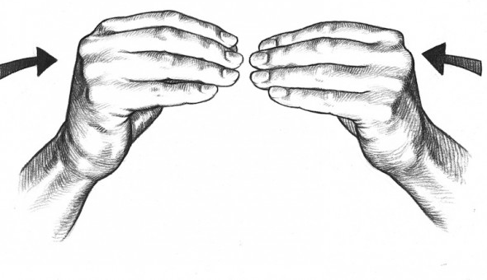
Add more tests
Our major smell was duplication
Get the duplicated methods under test

Slide 60
All Tests Pass

Slide 61
Can we make REAL changes yet?!

Slide 62
All Tests Pass – Refactoring Ready

Slide 63
Reminder –NO (FUNCTIONAL) CHANGE
Committed to stability
Eliminated duplication
Improved maintainability
Reduced complexity
Identified inconsistencies

Slide 64
Original Code
public function openCreateNewOrderPopUp():void
{
if (orderModel.inMSOState)
{
alertMSOToUser(RequestTypesBeforeSwitchingMSO.CREATE_NEW_ORDER)
}
else
{
var createOrderPopup:CreateOrderView = new CreateOrderView() ;
new SM_PopupComponentEvent(createOrderPopup,true).dispatch()
}
}

Slide 65
Refactored Code
public function openCreateNewOrderPopUp():void
{
if (modifyingSubmittedOrder()))
{
createAlert_ModifySubmittedOrder_Confirmation();
}
else
{
createPopup_CreateNewOrder();
}
}

Slide 66
Original & Refactored Code
if ( orderModel.inMSOState ) { alertMSOToUser(RequestTypesBeforeSwitchingMSO.CREATE_NEW_ORDER)
} else {
var createOrderPopup:CreateOrderView = new CreateOrderView() ;
new SM_PopupComponentEvent(createOrderPopup,true).dispatch()
}
if ( modifyingSubmittedOrder() ) {
createAlert_ModifySubmittedOrder_Confirmation();
} else {
createPopup_CreateNewOrder();
}
ORIGINAL
REFACTORED

Slide 67
That’s it?! It looks nearly the same? It *should* It does the same thing
100% API test coverage
Duplication eliminated
Consistent method naming

Slide 68
Refactored Consistent Protected Methods
createPopup_CreateNewOrder()
createPopup_QuickOrderEntry()
createPopup_ImportOrder()
createPopup_ExportOrder()
createPopup_CancelOrderWithNonEditableItems()
createPopup_ModifyOrderWithNonEditableItems()
createPopup(type)
createAlert_OrderPastCutOff()
createAlert_UnableToModifySubmittedOrder()
createAlert_DeleteOrder_Confirmation()
createAlert_CancelOrder_Confirmation()
createAlert_ModifyOrder_Confirmation()
createAlert_CancelSubmittedOrder_Confirmation()
createAlert(msg)

Slide 69
Moving out responsibilities
public function createPopup(type:String):void
{
var popup:UIComponent = popupFactory.create(type);
new SM_PopupComponentEvent(popup,true).dispatch();
}
public function createAlert(msg:String):void
{
alertFactory.create(msg)
}
Externalized object creation

Slide 70
Other Refactoring Benefits
Alert inconsistencies identified & backlogged
mx.Alert.show()
spark.Alert.show()
CustomAlert.show()

Slide 71
Metrics
 | Original | Refactored
Public methods | 58 | 58
Public variables | 28 | 28
Non-public methods | 18 | 57
PMD errors | 23 | 4
PMD warnings | 37 | 13
Import statements | 157 | 99
Tested methods | 0 | 58

Slide 72
Observations
Lessons Learned
And
Other Discoveries

Slide 73
Make a 2nd Draft
Anything that is important deserves / demands more than a first draft.

Slide 74
Be Responsible
Refactor responsibly
Only modify once tests are in place

Slide 75
Work small
Work in tiny increments
Refactoring is precision surgery
Refactoring != rewriting from scratch

Slide 76
Extract & Override Dependencies
Isolate
Creation code
Evaluation code
Control code
UI Code

Slide 77
Q&A
This presentation* is at
http://squaredi.blogspot.com
*and several other refactoring posts
Drew Shefman
@dshefman
dshefman@squaredi.com

Slide 79
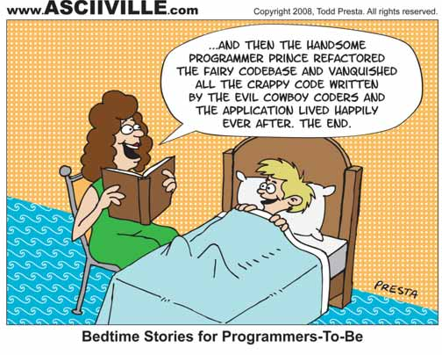

Slide 80
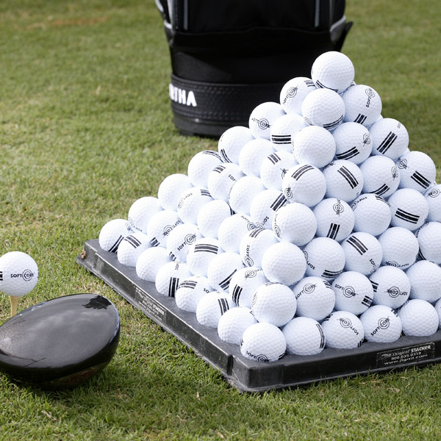
Practice
Use code katas, like the Gilded Rose, to practice refactoring in a safe environment.
https://github.com/ dshefman/ GildedRoseAS3
AS3 + other language versions:
http://craftsmanship.sv.cmu.edu/ posts/gilded-rose-kata

Slide 81
Only add value
Refactor only if it adds value to the business

Slide 82
Respect
“Regardless of what we discover, we understand and truly believe that everyone did the best job they could, given what they knew at the time, their skills and abilities, the resources available, and the situation at hand.”
-- Retrospective Prime Directive
http://www.retrospectives.com/pages/retroPrimeDirective.html

