Slide 1
Flex AdvancedDataGrid
Taming of the Beast
Drew Shefman
dshefman@squaredi.com
Blog: http://squaredi.blogspot.com/

Slide 2
Who are you?
Freelance Developer / Architect with 15 years of professional multimedia experience
Certified Flex Expert / Instructor
Professor of Multimedia @ University of Houston
Just finished 4+ months of AdvancedDataGrid customization for a client

Slide 3
What are you talking about today?
Useful design patterns for extending the grid, focusing on focus control examples
Bugs and gotcha’s within the grid

Slide 4
Outline
Extending the ADG
Design Patterns
Existing Bugs & Defects
Show me the Code – Focusing on Focus
File Structure
Q&A

Slide 5
Extending the ADG: Why?
80% of the screen was the ADG
80% of all of the possible screens had a grid on it
24 different grids to display the same data (Products)
Many developers around the world
Highly styled
Precision focus and tab control
Unique requirements
Bug Fixes

Slide 6
What sort of unique focus requirements?
0,1, or 2 editable fields per cell
Grouping and expanded rows that don’t have any focusable fields
Clicking anywhere in the row focuses on editable cell
First editable field gets focus when the grid appears
Some products are not editable
Set focus to a particular item from outside the grid

Slide 7
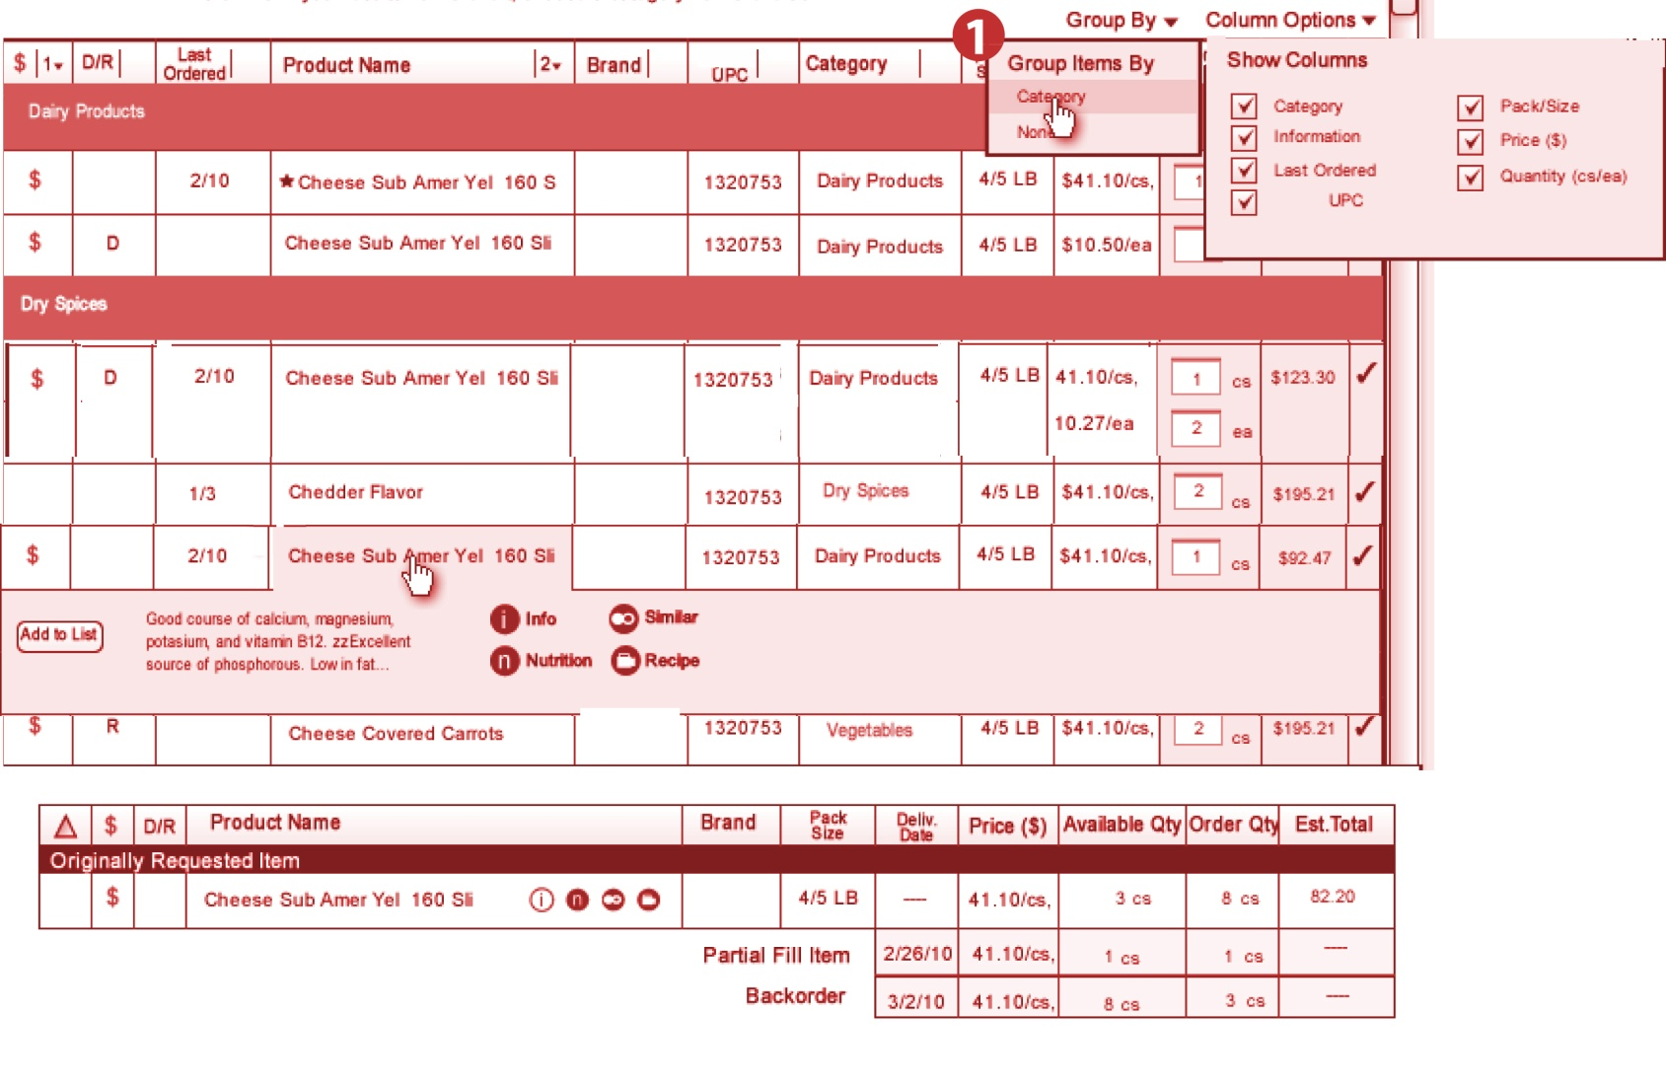
What sort of unique requirements?

Slide 8
Guiding Design Principles
Very easy to read and understand
Swappable functionality on an instance level
Single reference point for all grids
Unit Testable
Efficient; enabling features only as needed
100% decoupled from Data, Models, Framework
Still *is* an AdvancedDataGrid to the developers

Slide 9
So how do you meet your goals?
Delegate as much work as possible to other classes
Keep methods small (<5 lines) to make it readable
Create as many “seams” as possible

Slide 10
Is there a key ingredient to focus?
Q: What happens internally when we focus into an editable cell?
A:
editedItemPosition is updated to reflect the row & column index of the edited position
An itemEditorInstance is created. Even if the renderIsEditor = true, you still get a new instance.

Slide 11
Demo
Show me the focus!

Slide 12
Design Patterns
Warning:
Some might be custom
Or newly created
Due to limited research time

Slide 13
Interceptor Pattern
Purpose:
To grab an incoming property value, modify it, then pass the modified value to the property.
Implementation:
override public function set property (v:*):void
{
super.property= interceptor.modifyProperty(v)
}
Example reference ADGBase -> set columns()

Slide 14
Accessor Pattern
Purpose:
Provides access to public properties of a class.
Implementation:
In its simplest form, it exposes the same public properties as the class that it is exposing.
It is needed for unit testing, in which setting some of these properties creates a series of events that is difficult to test.
var gridAccessor:IGridAccessor = new GridAccessor(this);
Example reference: GridFocusDelegate constructor

Slide 15
Evaluator Pattern
Purpose:
To extract common business questions into a method that typically returns a boolean
Implementation:
if (evaluator.isProductInOrder(product))
if (evaluator.isProductOrderable(product))
if (evaluator.isProductPromotion(product))
Example reference GridFocusDelegate -> isDataRowIndexEditable()

Slide 16
Delegate Pattern
Purpose:
To offload all additional functionality, calculations, processing, etc that doesn’t directly set a property on the grid.
Example reference ADGSeam -> setFocusFirst()

Slide 17
Bug Fixes? Like What
Gotcha’s,
pitfalls,
Defects,
and other hidden “features”

Slide 18
Defect: findNextItemEditor
Problem
Solution
When tabbing, it is really hard to tell it to ignore a particular item
Like an out of stock item or a read only item
Override protected method isDataEditable
Example reference

Slide 19
Bug: editable=“true”
Problem
Solution
If you have editable=“true”
Yet you don’t set any columns to editable=“true”
RTE on the focusInHandler, which could occur on Tab or setFocus()
Override focusInHandler to error handle editedItemPosition which is left “out of range” after an internal for loop
Example reference

Slide 20
Defect: RendererProviders
Problem
Solution
RendererProviders take an explicit columnIndex
Yet, they could span all of the columns
If the first column is hidden, the rendererProvider doesn’t show at all.
Track the columnIndecies
Shift referenced values when a column is hidden
Example reference

Slide 21
Defect: Dragging an editable grid
Problem
Solution
Dragging and editable enabled
renderIsEditor = true
User is unable to select/hilight field without dragging
Override mouseMoveHandler and check for an itemEditorInstance != null

Slide 22
Defect: Editing a sorted field
Problem
Solution
Column sort applied
Edit a field in that column
When user commits (tabs away), the row might disappear based on sort.
Scenario: Sort on quantity. Change 3 to 10. Row of interest jumps offscreen to meet sort critiera
Disable sorting when editing the sorted field.

Slide 23
Bug: HierarchicalViewCollection refresh
Problem
Solution
HierarchicalViewCollection doesn’t listen for a refresh event on its underlying source collection
Specifically watch for the “filterFunctionChanged” event and manually call refresh on the HierarchicalCollection

Slide 24
Bug: HierarchicalCollectionView openNodes
Problem
Solution
Reusing a dataprovider with open nodes, will cause a performance slowdown due to caching of openNodes
hierarchicalCollectionView.openNodes = {}

Slide 25
Structure
How to set up these files

Slide 26
Structure
  MyADGBugFix
    Specifically for Flex based bugs
  MyADGBaseClass
    Used as a extensible library for common features
  ClientADGBaseClass
    Specific client functionality
  ClientADGFactory
    Enumerate all of the grids that the client has

Slide 27
FAQ & Q&A

Slide 28
FAQ - How to solve an RTE
It will likely happen in commitProperties or updateDisplayList, or some method that is called from them
if method is override-able, you might be able to trap the error. More then likely you can’t.
Look at all of the conditions, properties, and “seams” into this method for a way out of it. You’ll have to do some class inheritance jumping.
Override / validate the property / method that you have access to.

Slide 29
Q & A
Drew Shefman
dshefman@squaredi.com
Blog: http://squaredi.blogspot.com/

